Slide 1

Yael Tauman Kalai
Microsoft and MIT

Slide 2
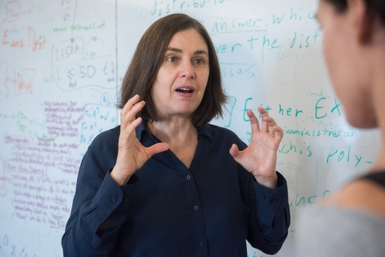
Standardize ZK
People are using ZK Proofs,
better do it right!
Following the effort of standardizing FHE

Slide 3
Goal:
Create an agreement on a cryptographic object (ZK proof):
Interactive/non-interactive?
Common random/reference string?
Security?
Assumption?
Heuristic?
Parameters?
Code?

Slide 4
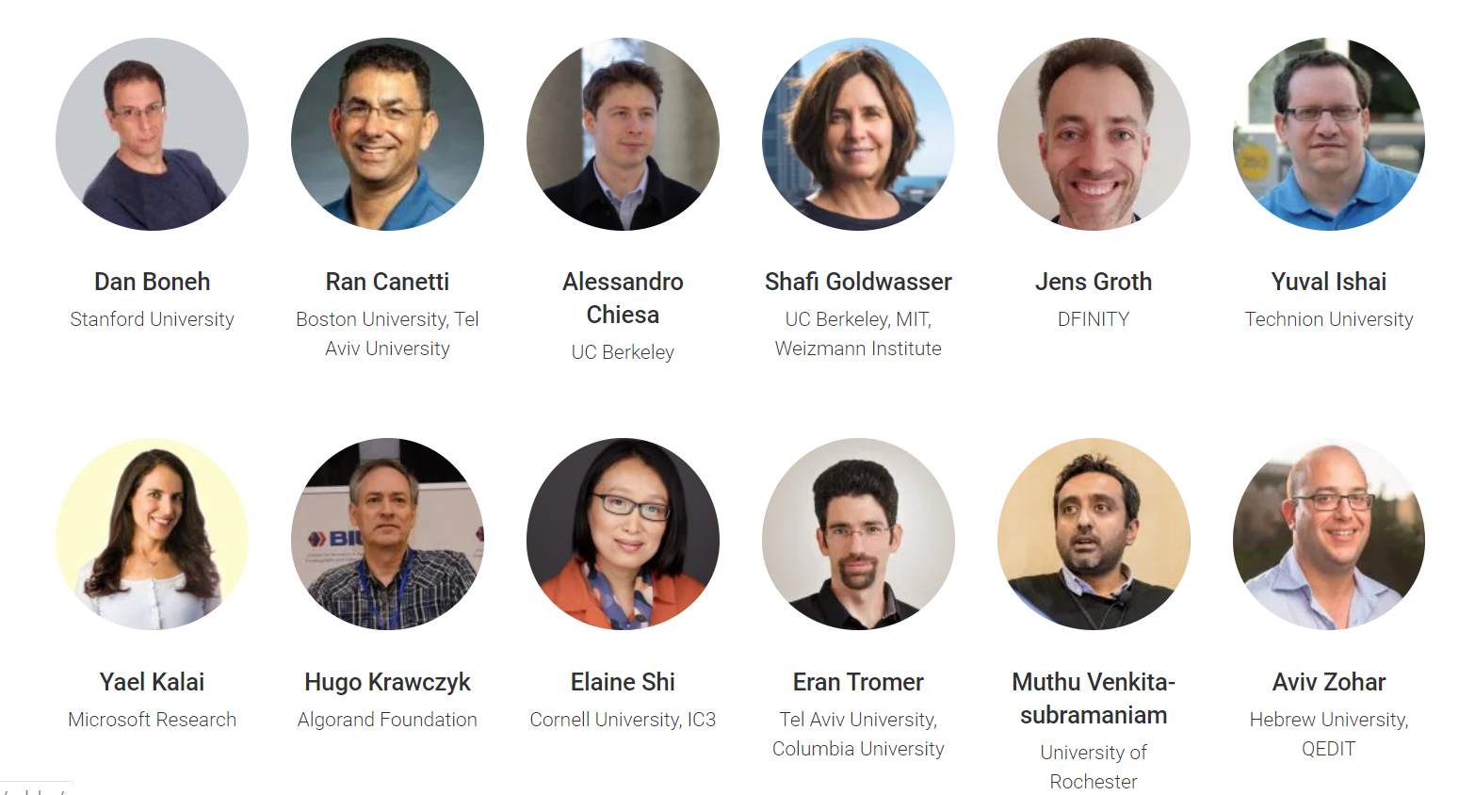
The Steering Committee

Slide 5
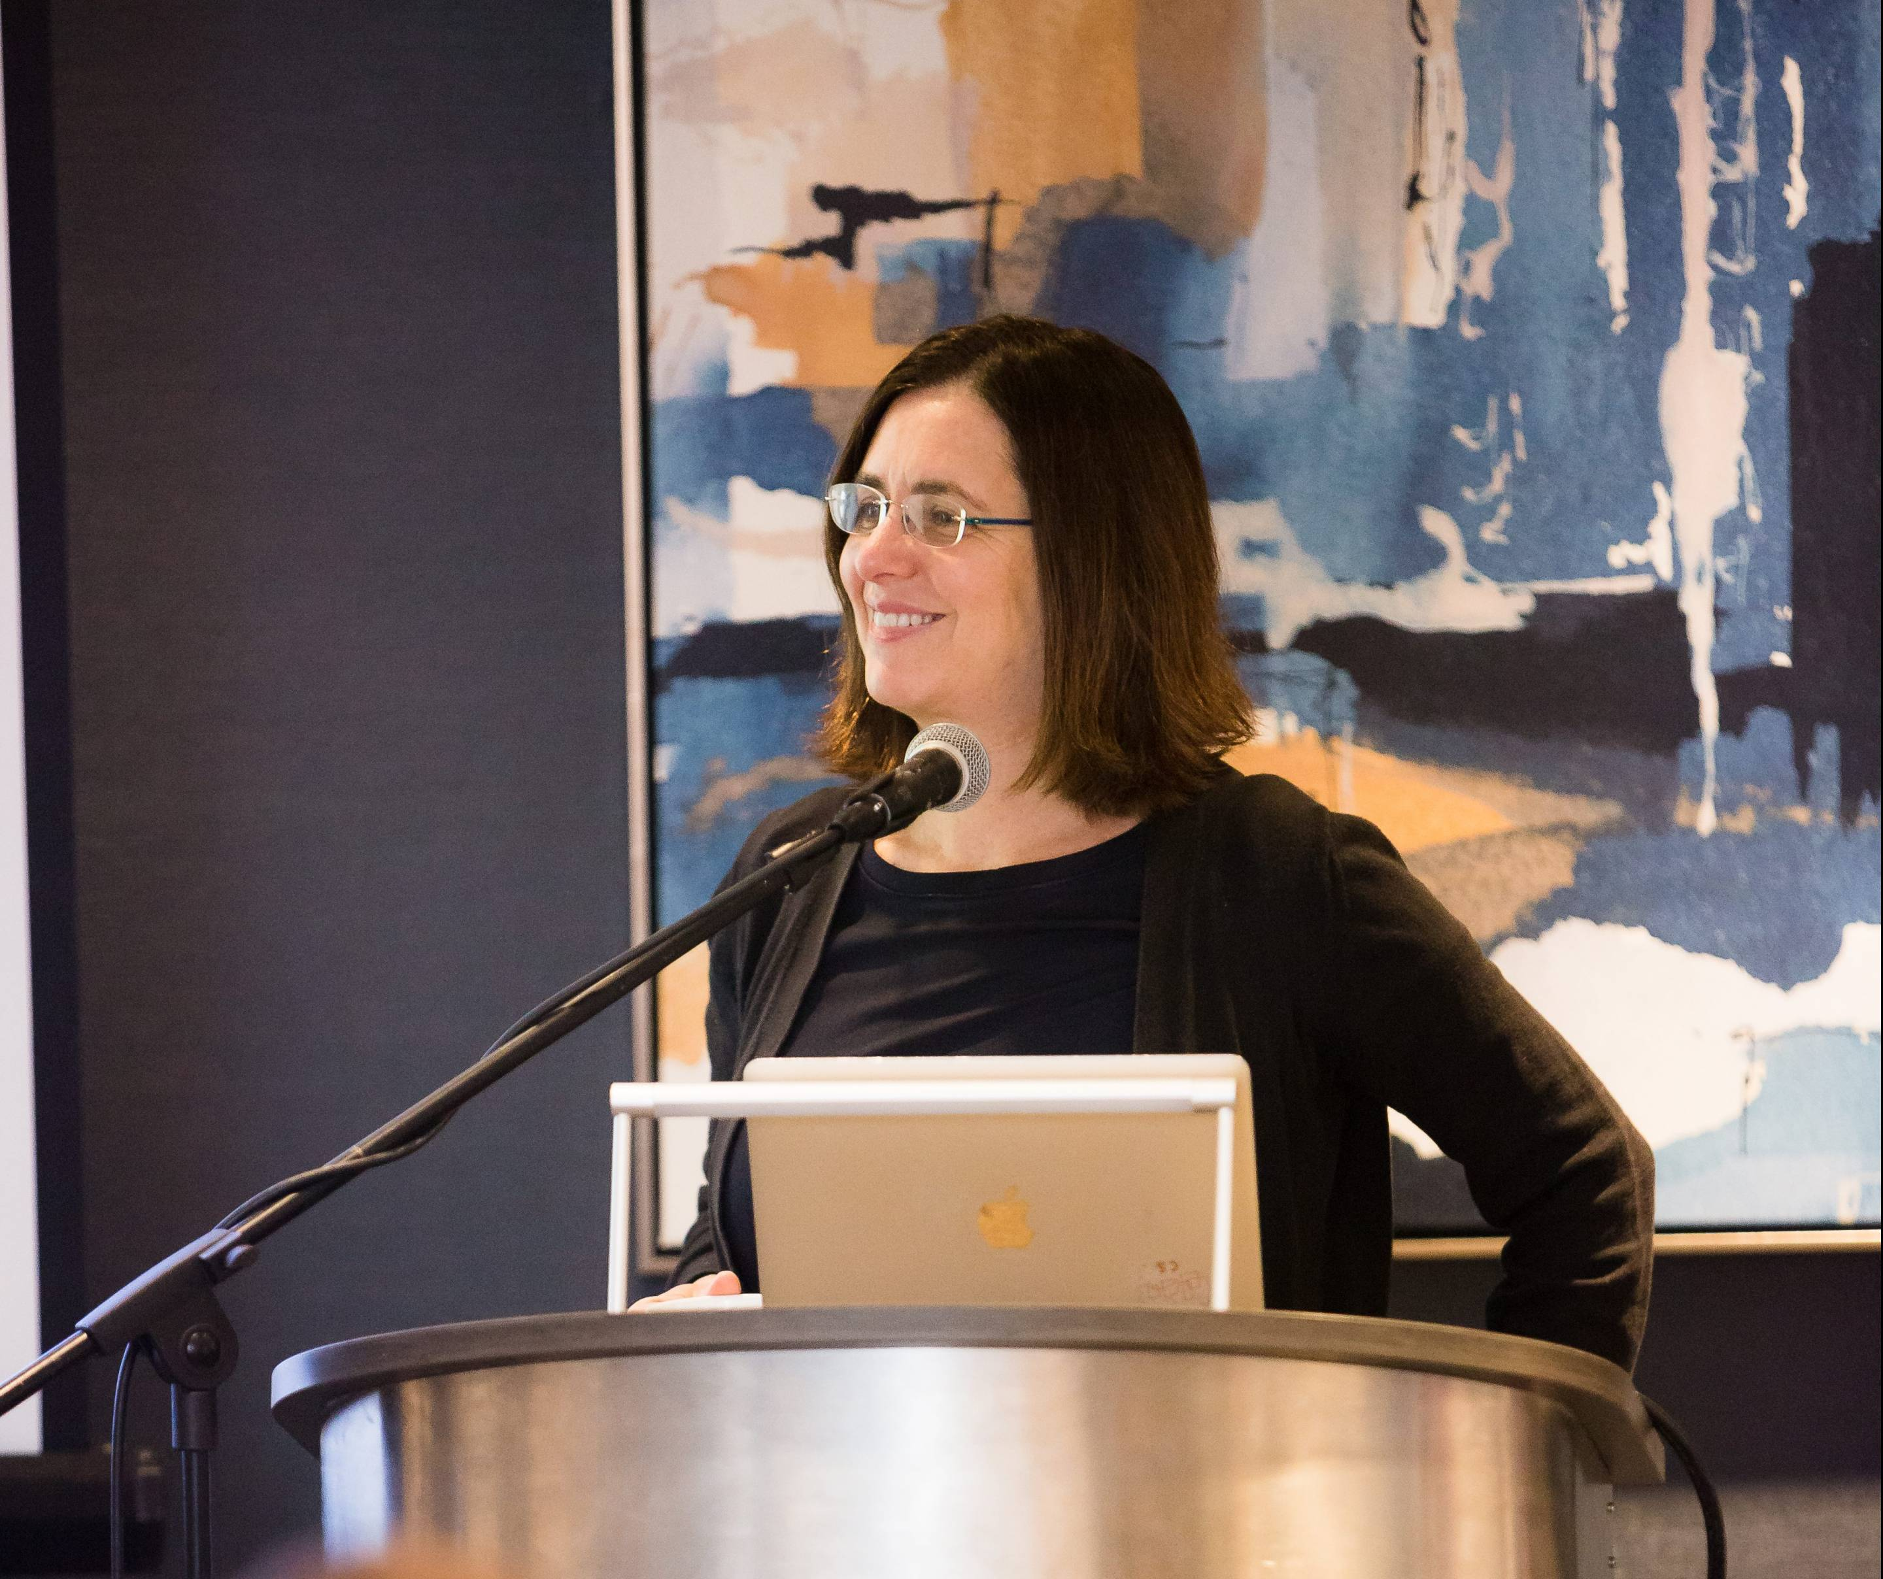
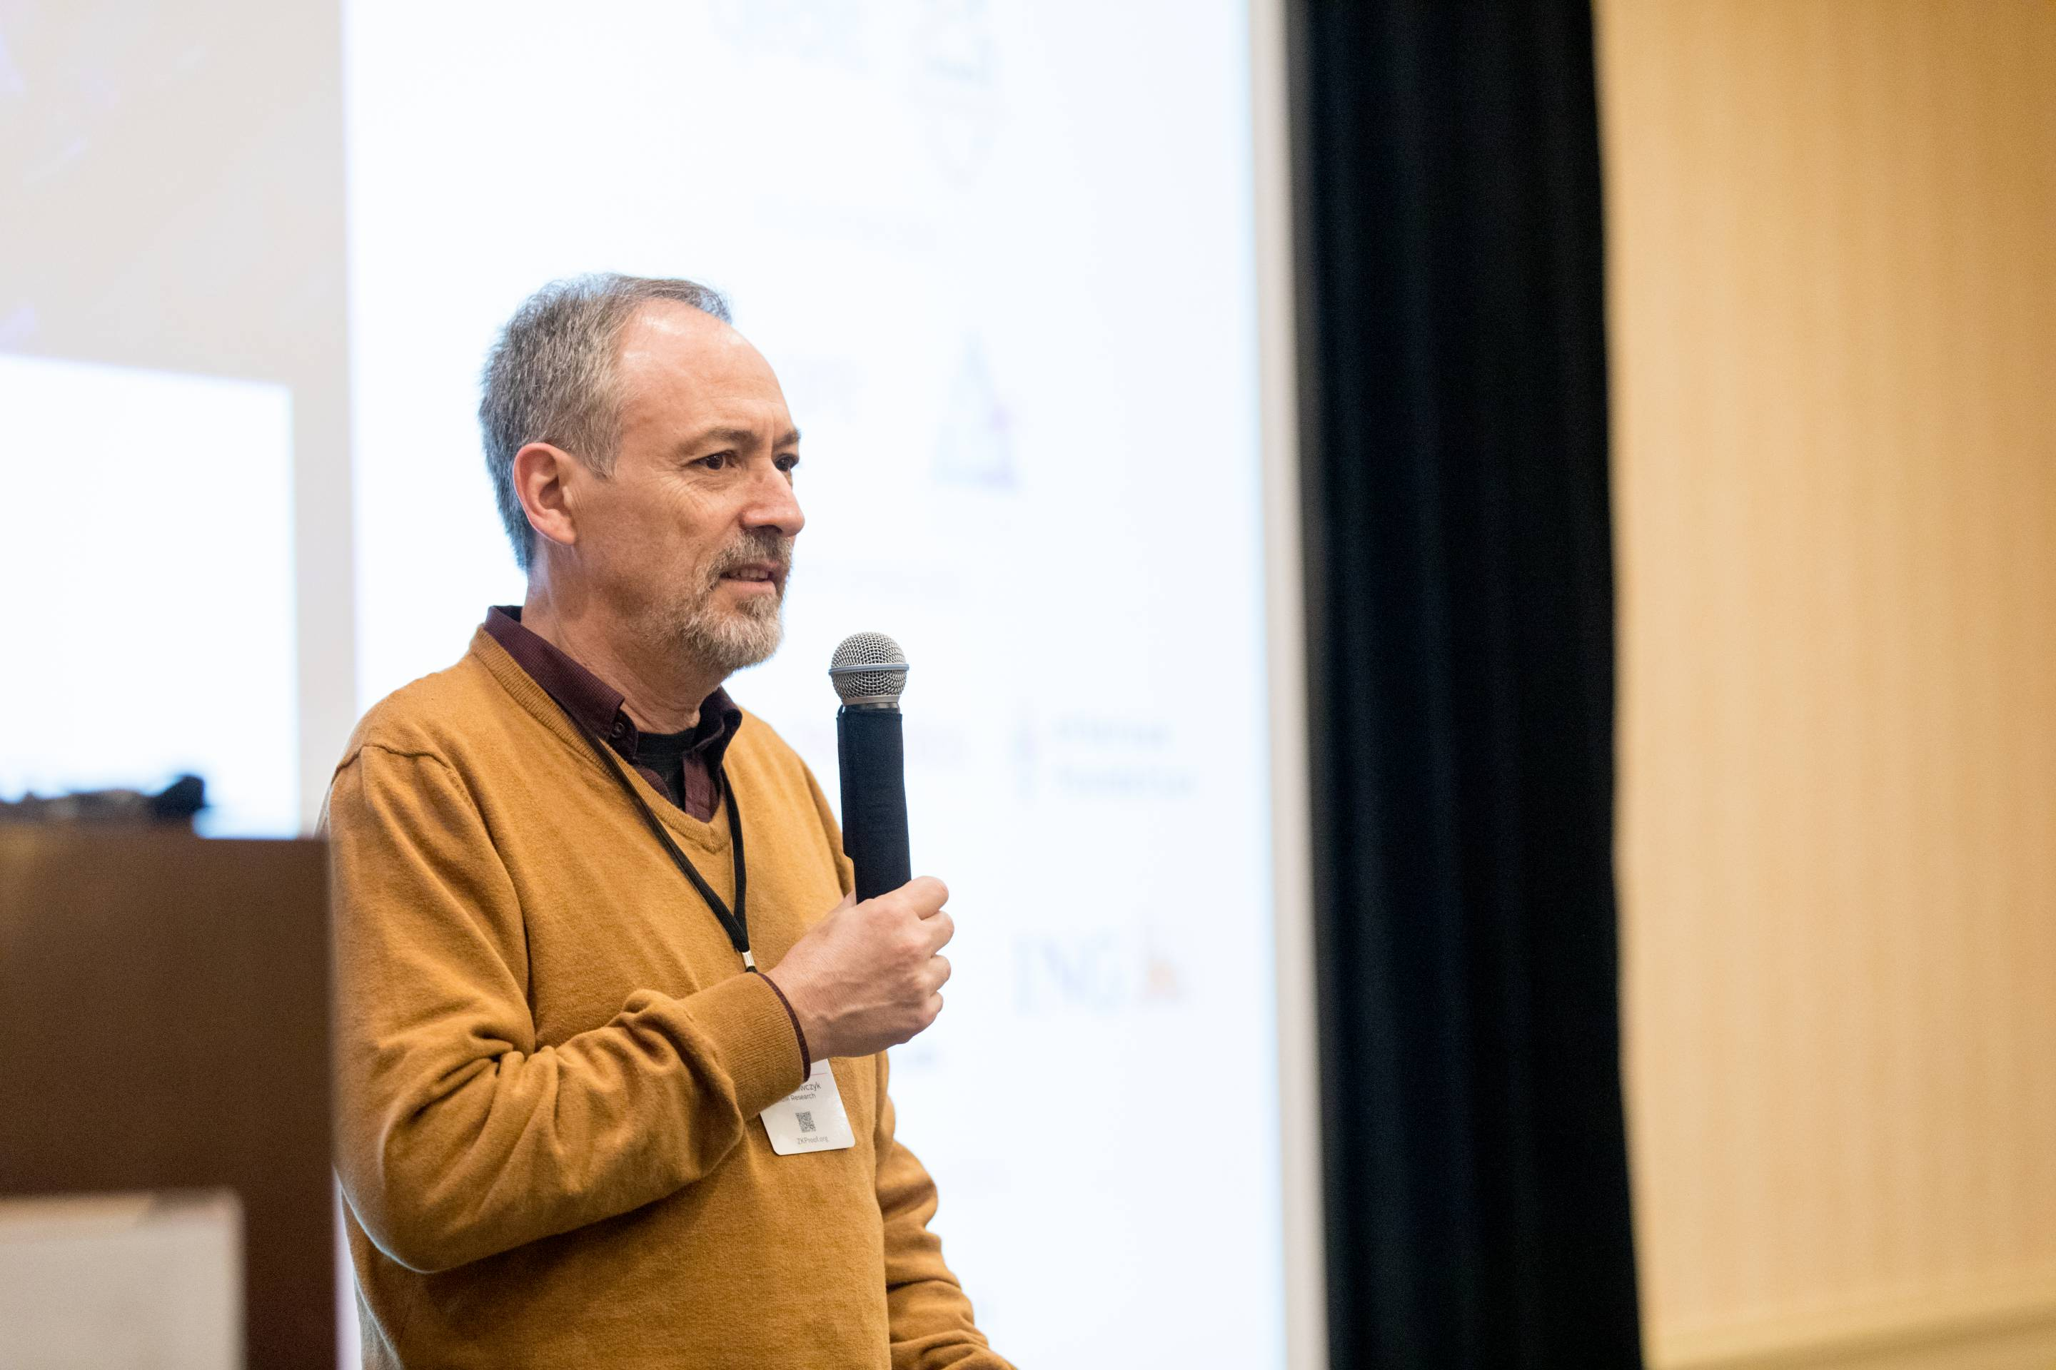
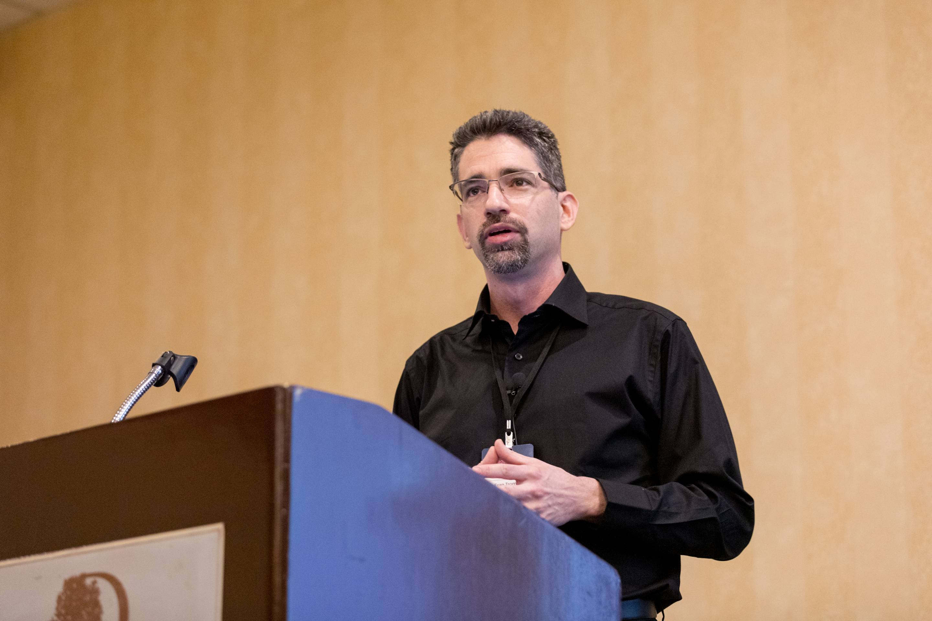
Notes:
Talks

Slide 6

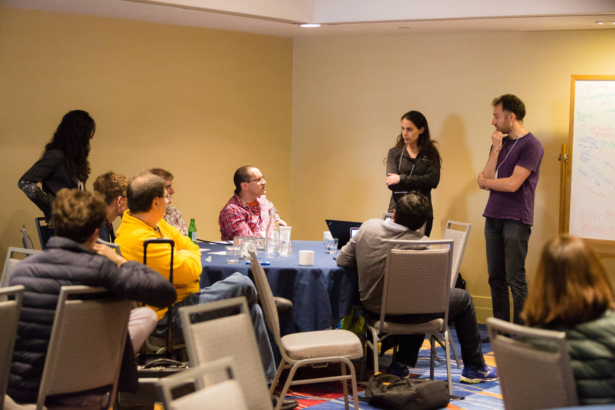
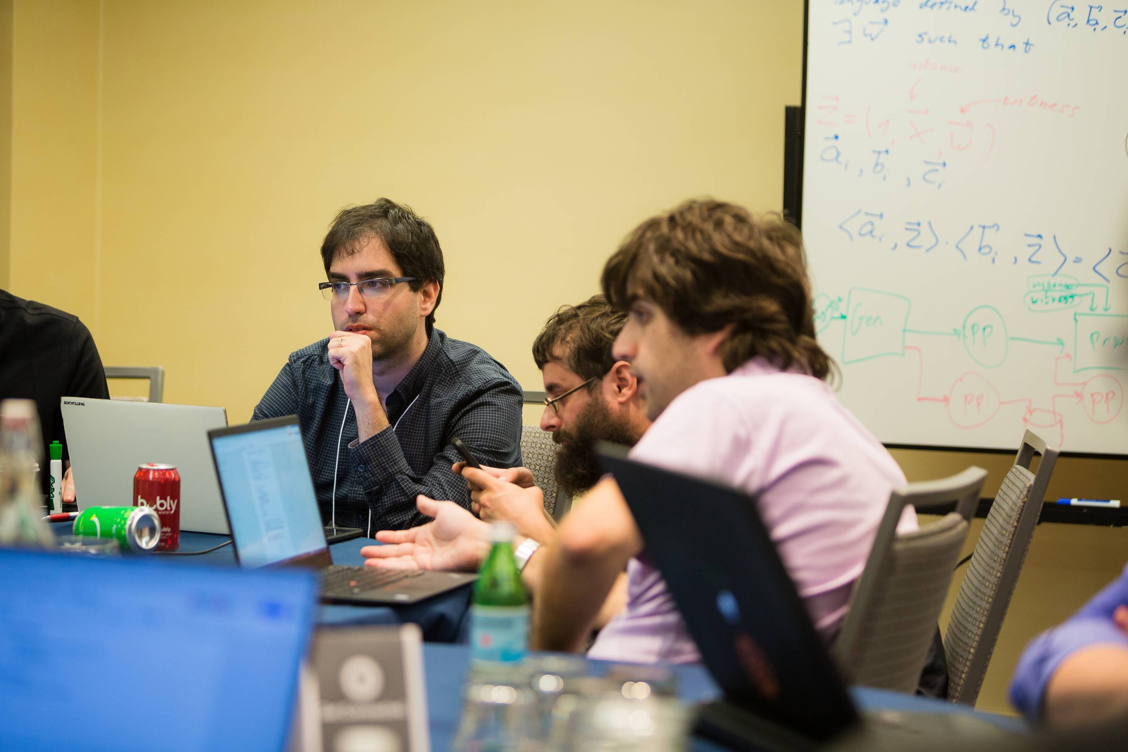
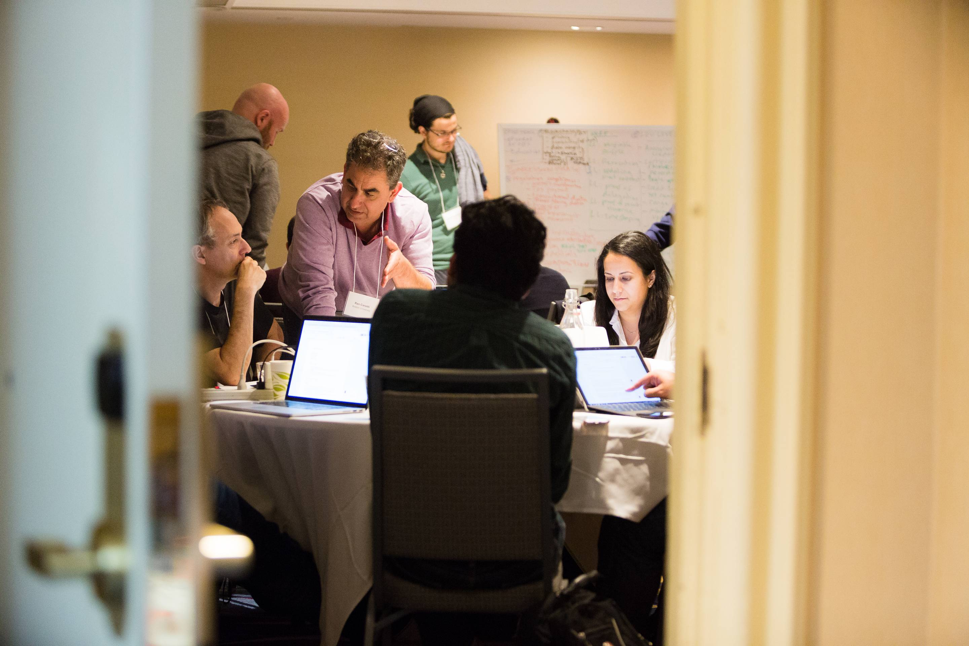
Breakout discussions:
benchmarking security
applications
implementations

Slide 7
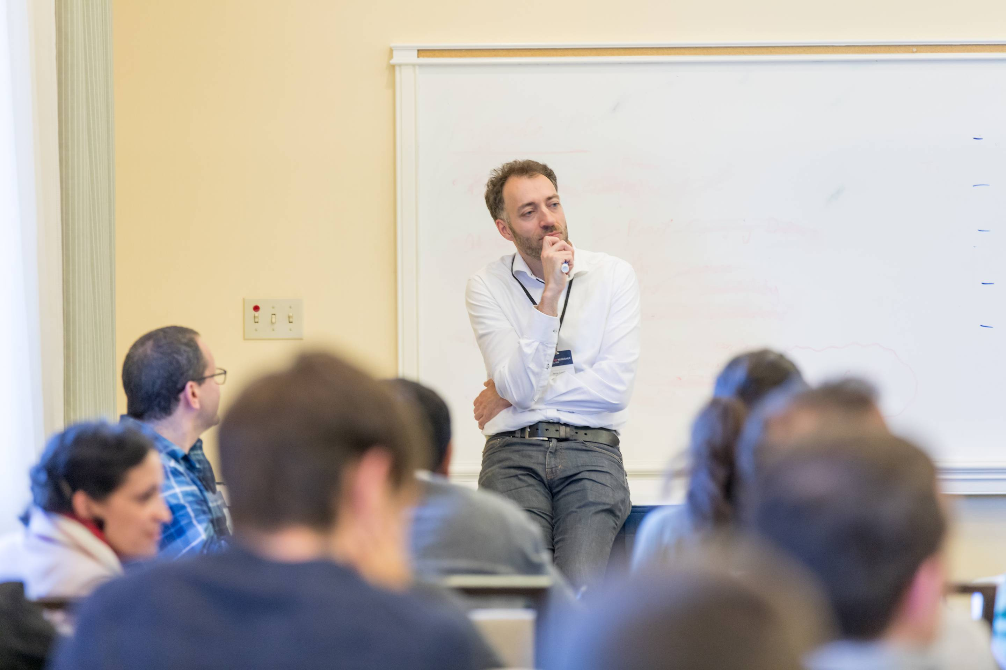
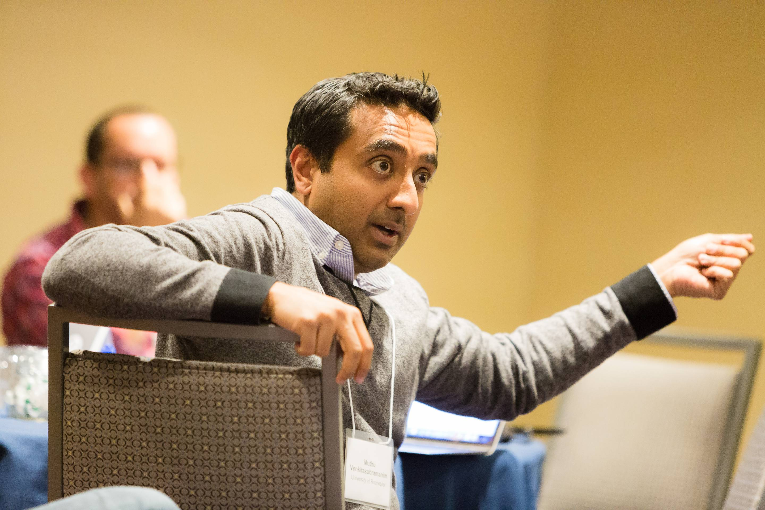
Notes:
Think, argue

Slide 8
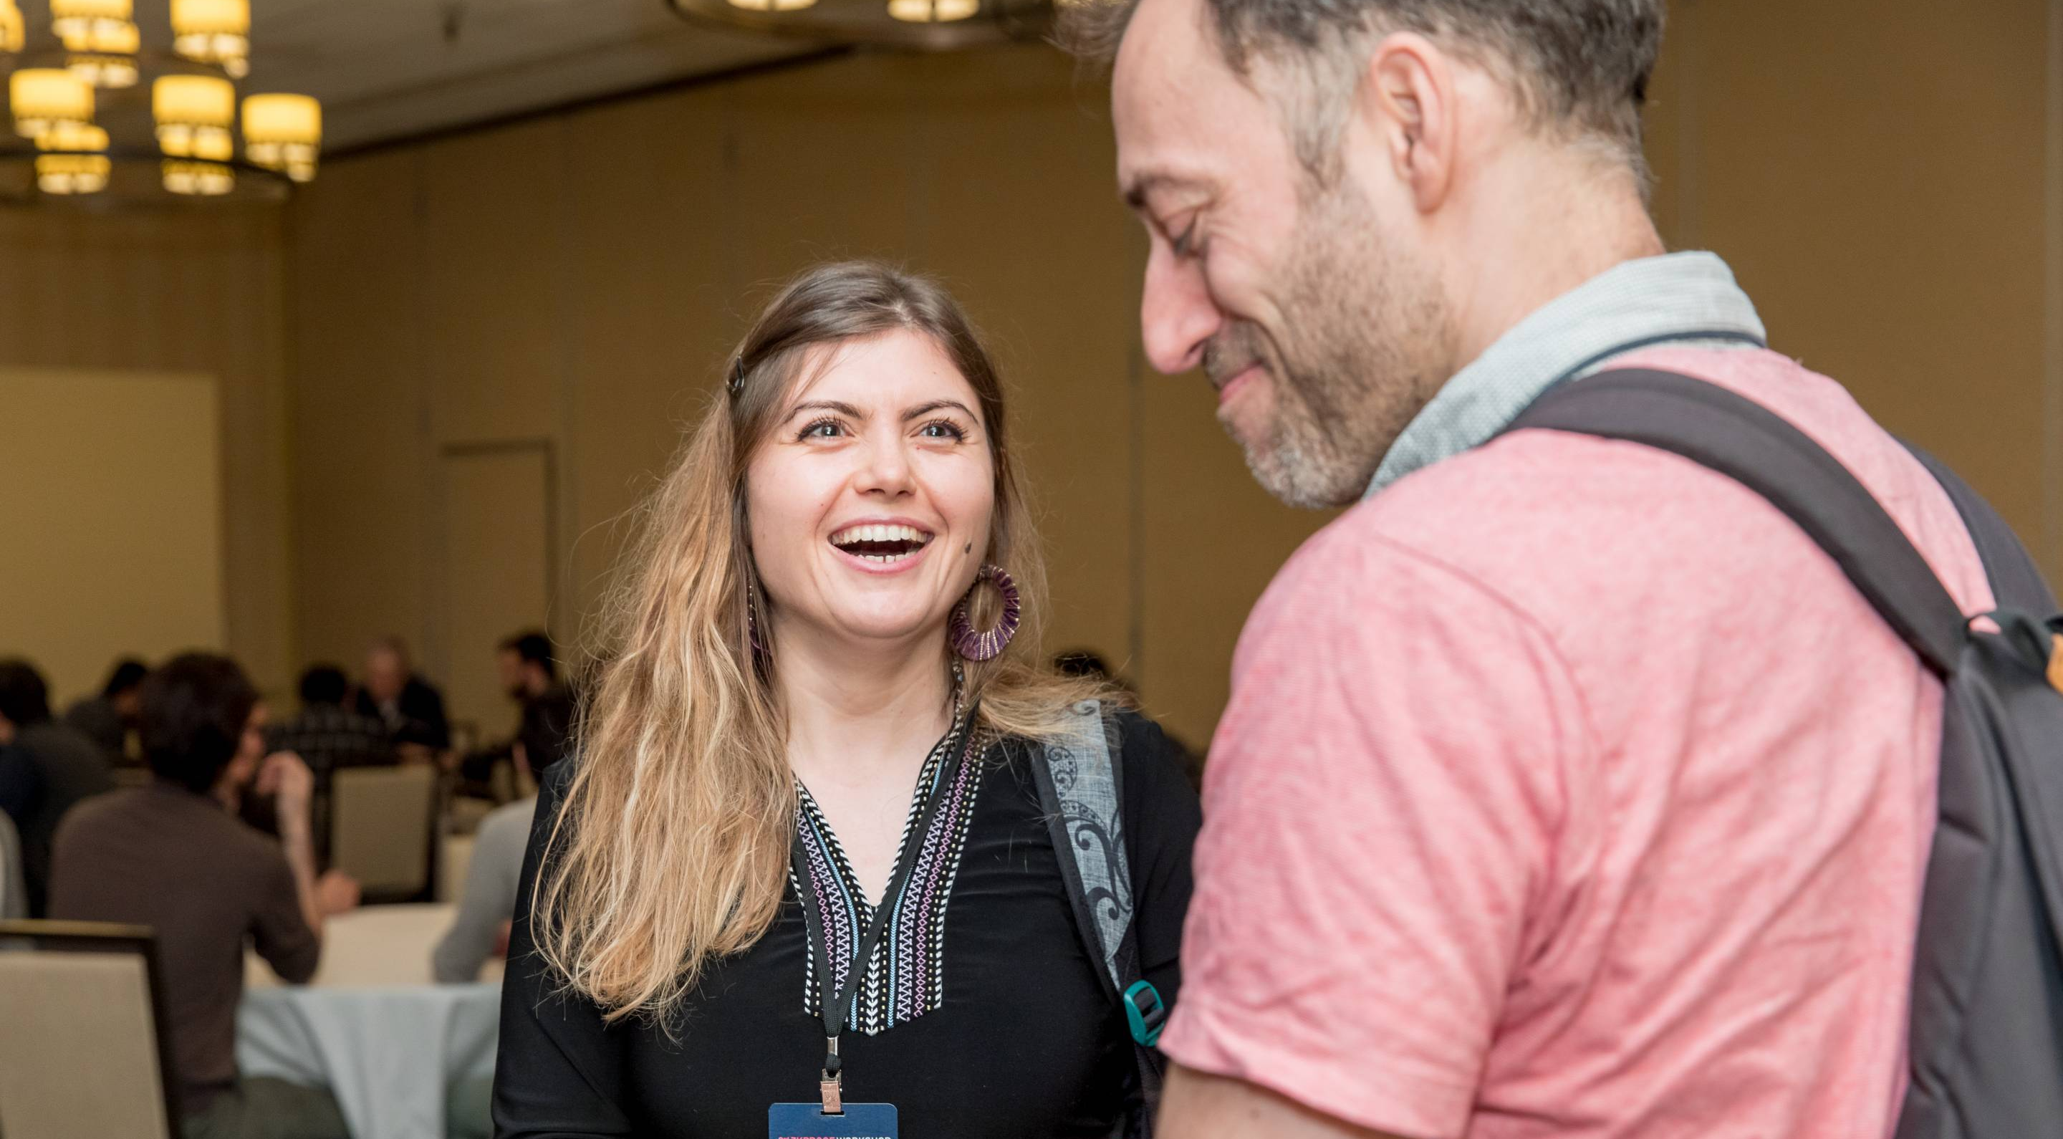
Notes:
Laugh, have fun

Slide 9
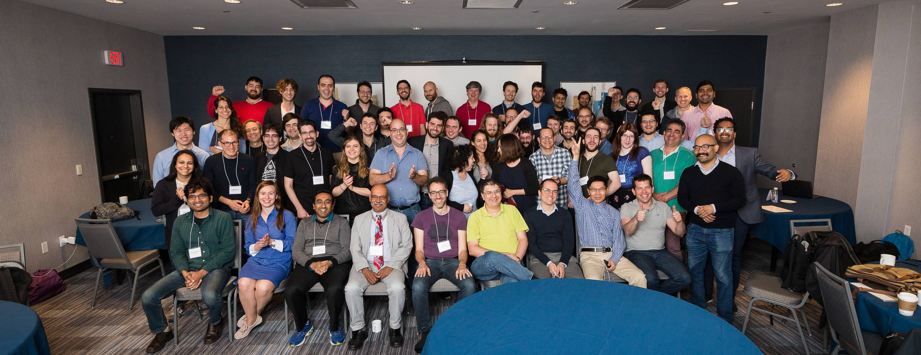
Our Community
Notes:
Build a community.
Amazing to see the broad and vast interest in ZK proofs.

Slide 10
The Vision
Educational
Advance the state-of-the-art research on ZK proofs
Standardization: facilitate adoption
Support the field and mainstream ZK proofs

Slide 11
The steps we took in numbers
1st Workshop
2nd Workshop
3rd Workshop
70 participants
150 participants
240 participants
3 documents produced (v0.0 of reference doc)
4 papers accepted & v.0.1 of reference doc
12 proposals and SoKs & v0.2 of reference doc
Notes:
One step at a time.
We saw the first workshop as an experiment, there were 70 researchers trying to agree on the most basic issues: terminology. To our surprise, it was a success and the participants produced 3 documents on security, implementation and applications that became the basis of the ZKProof community reference document.
For the second workshop, we wanted to scale, both in numbers and in quality, to continue building something important, so we opened the first call for proposals. Another successful experiment that saw 7 total submissions and 4 accepted papers. This was also the first time we collaborated with external organizations on the ZKProof reference.
We are here today, after two years and 5 events. There is a clear interest from the industry to create standards and to make this technology adopted. We know because we had a total of 23 submissions, of which 12 papers were accepted. Specifically, 9 proposals and 3 systematization of knowledge papers.
This workshop also comes with an experiment as it is the first time that we have setup working groups to enable the proper development of the proposals into standards.
We are still building upon our original work, the reference documentation.

Slide 12
Our Mission
We are an open initiative that seeks to mainstream zero-knowledge proofs through an inclusive, community-driven standardization process that focuses on interoperability and security.
Notes:
welcoming remarks

Slide 13

Notes:
welcoming remarks

Slide 14
